Slide 1
20XC15 -Problem Solving and C Programming

Slide 2
Outline
Problem Solving
Program Development Steps
  Define the Problem
  Outline the Solution
  Develop Algorithm
  Test the Algorithm for Correctness
  Code the Algorithm
  Compile
  Run the Program
  Test, Document and Maintain the Program
Programming Language

Slide 3
Problem Solving
The process of taking the statement of a problem and developing a computer program that solves that problem
Programming - a problem-solving activity
Computer Program
  A computer program is a set of formal instructions, which the computer executes in order to carry out some designated task

Slide 4
Program Development Steps
1. Define the Problem
  First of all, the problem should be clearly defined
  The problem can be divided into three components
    Inputs – What do you have?
    Outputs – What do you want to have?
    Processing – How do you go from inputs to outputs?
Programmers should clearly understand “what are the inputs to the program”, “what is expected as output(s)” and “how to process inputs to generate necessary outputs”

Slide 5
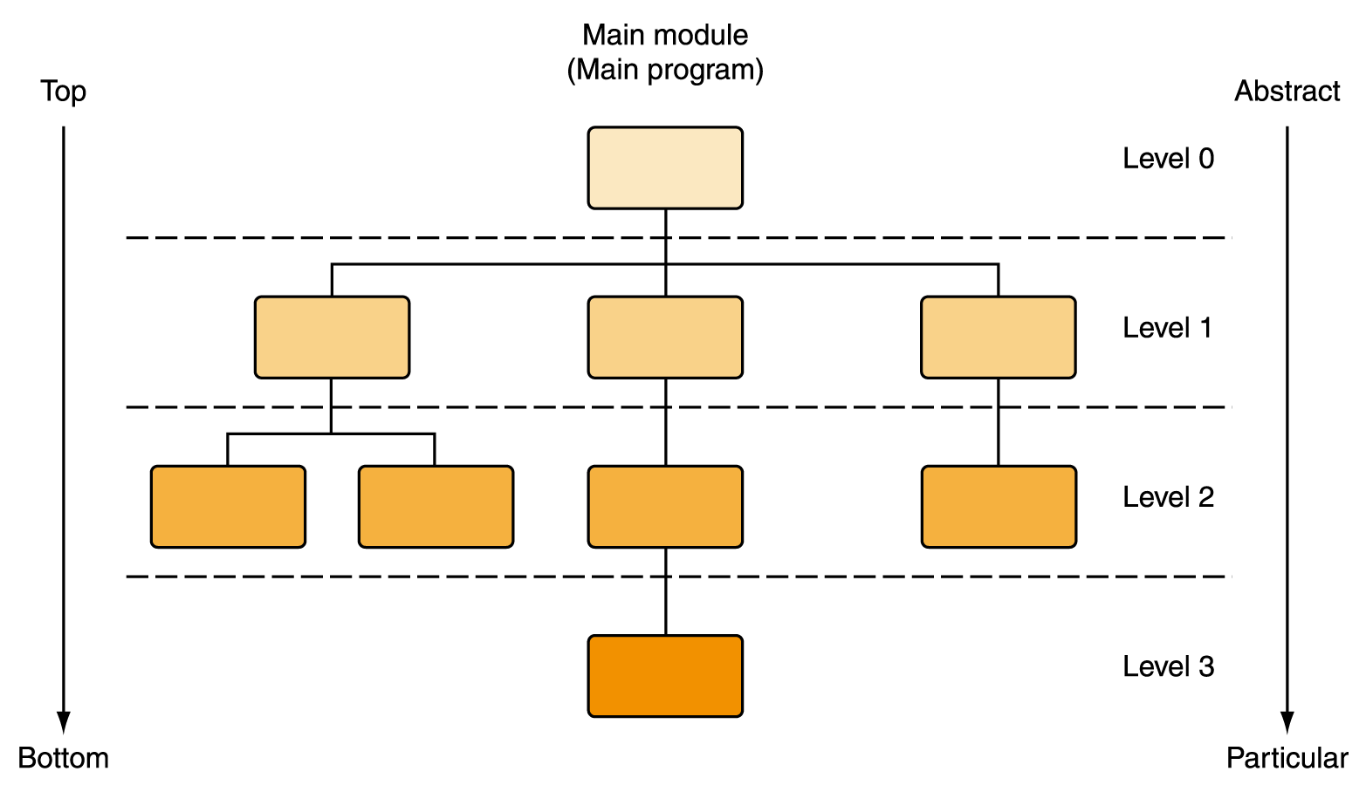
Program Development Steps
Example : A computer program is to be written to calculate and display the circumference and area of a circle when the radius is r
    Inputs: the radius (r)
    Outputs: circumference (c) and area (a)
    Processing: c = 2πr, a = π r²
2. Outline the Solution
  The programmer should define
    the major steps required to solve the problem
    any subtasks
    the major variables and data structures
    the major control structures (e.g. sequence, selection, repetition loops) in the algorithm
    the underlined logic

Slide 6
Program Development Steps
Example - Calculate and display the circumference and area of a circle when the radius is r
  In order to calculate the circumference
  Variables: radius (r), circumference (c)
  Calculation: c = 2 π r
  In order to calculate the area
  Variables: radius (r), area (a)
  Calculation: a = π r

Slide 7
Program Development Steps
3. Develop the Algorithm
An algorithm is a well defined finite number of ordered Instructions which takes input and gives correct output
Efficiency of an algorithm can be evaluated on the basis of following parameters.
Time complexity
  The amount of computer time required by the algorithm for its execution.
Space complexity
  Refers to the amount of memory required by the algorithm for its execution and generation of final output

Slide 8
Characteristics of Algorithm
Input
  Takes zero or more inputs
Output
  Can be proved to produces the correct output, given a valid input
  One or more outputs may result
Finiteness
  Terminates after a finite number of steps
  All operations are carried out in finite time
Definiteness
  Each step must be readable, understandable and unambiguously specified
Effectiveness
  Steps are sufficiently simple and basic

Slide 9
Program Development Steps
  Designing the algorithm to solve a problem requires to develop a list of steps to solve a problem and to then verify that the algorithm solves the problem as intended
  Pseudocode - an artificial and informal language that helps programmers develop algorithms. Pseudocode is very similar to everyday English
  For Example
    Write an algorithm to determine a student’s final grade and indicate whether it is pass or fail. The final grade is calculated as the average of four marks

Slide 10
Pseudocode & Algorithm
Pseudocode
Input a set of 4 marks
Calculate their average by summing and dividing by 4
if average is below 50
Print “FAIL”
else
Print “PASS”

Slide 11
Pseudocode & Algorithm
Detailed Algorithm
Step 1: Input M1,M2,M3,M4
Step 2: GRADE ← (M1+M2+M3+M4)/4
Step 3: if (GRADE < 50) then
Print “FAIL”
else
Print “PASS”
endif

Slide 12
Program Development Steps
  Calculate the circumference and area of a circle
    Step 1: Start
    Step 2 : Input r
    Step 3 : Calculate circumference c = 2 * PI* r
    Step 4 : Calculate area a = PI * r ^ 2
    Step 5 : Output c & a
    Step 6 : End
Notes:
pseudocode is a simple and concise sequence of English-like instructions to solve a problem.

Slide 13
Program Development Steps
Algorithm : To find largest of three numbers
  Step 1 : Start
  Step 2 : Read 3 numbers: num1, num2, num3
  Step 3 : if num1 > num2 then
  Step 4 : if num1 > num3 then
  print num1 is largest
  else
  print num3 is largest
  Step 5 : else if num2 > num3 then
  print num2 is largest
  else
  print num3 is largest
  Step 6 : End
num1= 10
num2= 5
num3= 11

Slide 14
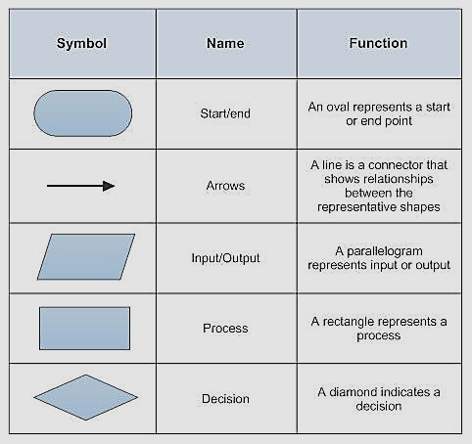
Program Development Steps
Flow Chart
  It is a pictorial representation of the algorithm depicting the flow of control in the algorithm

Slide 15
Program Development Steps
  Calculate the circumference and area of a circle
    1: Start
    2 : Input r
    3 : Calculate circumference c = 2 * PI* r
    4 : Calculate area a = PI * r ^ 2
    5 : Output c & a
    6 : End
START
Input
r
c= 2*pi*r
a= pi*r*r
output
c,a
STOP
Notes:
pseudocode is a simple and concise sequence of English-like instructions to solve a problem.

Slide 16
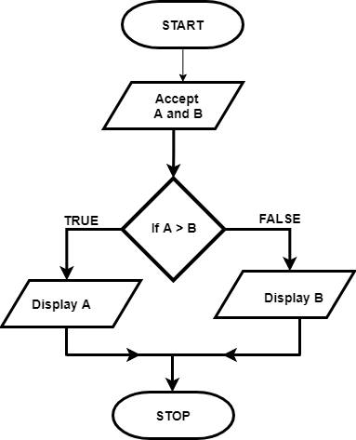
Program Development Steps
To find greatest of two numbers
  STEP 1: Start
  STEP 2: Read two numbers A and B
  STEP 3: if A> B
  Print A is greater
  else
  Print B is greater
  STEP 4: Stop

Slide 17
Program Development Steps
4. Test the Algorithm for Correctness
  The programmer must make sure that the algorithm is correct. The objective is to identify major logic errors early, so that they may be easily corrected
  Test data should be applied to each step, to check whether the algorithm actually does what it is supposed to
  Our simple example ( area and circumference of a circle), it is quite easy to check by submitting some values for radius (r) and walking through the algorithm to see whether the resulting output is correct for each input

Slide 18
Program Development Steps
5. Code the Algorithm
  After all the design considerations have been met and when the algorithm is finalised, code it using a suitable programming language
6. Compile
  Syntax errors can be identified
  Syntax errors - program statements does not adhere to the programming language
    These errors occur mostly due to miss typed characters, symbols, missing punctuations, etc.
  If there are no syntax errors the program gets compiled and it produces an executable program

Slide 19
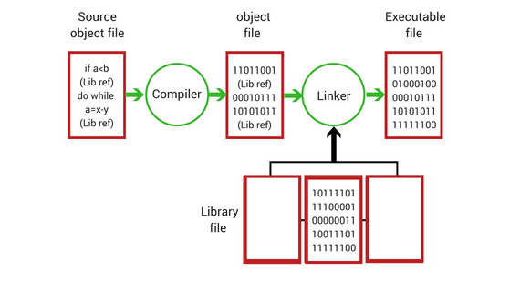
Program Development Steps

Slide 20
Program Development Steps
7. Run the Program
  Executable program generated after compilation can then be executed
  While the program is running runtime errors can be identified
  Runtime errors occur while executing the program and those are mostly due to incorrect inputs
    Example
      Result = 15 / 0;

Slide 21
Program Development Steps
8. Test, Document and Maintain the Program
  Test the running program using test data to make sure program is producing correct output(s)
    Run the program several times using different sets of data to make sure that it works correctly
  All the steps involved in developing the program algorithm and code should be documented for future reference
  Programmers should also maintain and update the program according to new or changing requirements
    Maintaining and updating the program involves modifying a program to remove previously undetected errors and to keep it up-to-date as government regulations or company policies change

Slide 22
Programming Language
A programming language is a set of rules that provides a way of telling a computer what operations to perform
English is a natural language. It has words, symbols and grammatical rules
A programming language also has words, symbols and rules of grammar
The grammatical rules are called syntax.
Each programming language has a different set of syntax rules

Slide 23
Why are there so many Programming Languages?
Programming languages have evolved over time as better ways have been developed to design them
  First programming languages were developed in the 1950s
  Since then many languages have been developed
Different programming languages are designed for different types of programs
  FORTRAN - numerical computing
  Simula - simulation
  Prolog - natural language processing
  Lisp - artificial intelligence
  C, C++, Java, C# and Visual Basic - used to develop a variety of applications

Slide 24
Levels of Programming Languages
High-level program
class Triangle {
...
float surface()
return b*h/2;
}
Low-level program
LOAD r1,b
LOAD r2,h
MUL r1,r2
DIV r1,#2
RET
Executable Machine code
0001001001000101001001001110110010101101001...

Slide 25
Generations of Programming Languages
  First Generation Languages
  Second Generation Languages
  Third Generation Languages
  Fourth Generation Languages
  Fifth Generation Languages

Slide 26
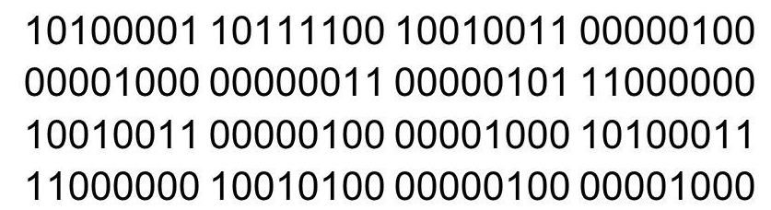
First Generation Languages
  Machine language
    Machine language is a collection of binary digits or bits that the computer reads and interprets
    Machine language is machine dependent as it is the only language the computer can understand
    Very efficient code but very difficult to write
    Example

Slide 27
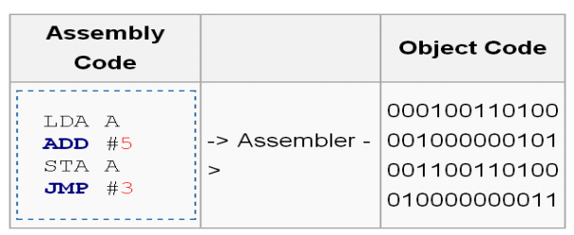
Second Generation Languages
  Assembly language
    A program written in assembly language consists of a series of instructions mnemonics (ADD,SUB,MUL,DIV,MOV,etc.) that correspond to a stream of executable instructions, when translated by an assembler, that can be loaded into memory and executed
    Computers do not understand the assembly code, so we need a way to convert it to machine code, which the computer does understand
    Assembly language programs are translated into machine language by a program called an assembler

Slide 28
Third Generation Languages
Closer to English but included simple mathematical notation (High-Level Languages)
  Programs written in source code which must be translated into machine language programs called object code
  The translation of source code to object code is accomplished by a machine language system program called a compiler or interpreter
  Common third generation languages
    FORTRAN, COBOL, C, C++, Pascal, Java, etc.

Slide 29
Fourth Generation Languages
A very high-level language (4GL) that requires fewer instructions to accomplish a task than a third generation language - non-procedural language
Used with databases
  Query languages
  Report generators
  Forms designers
  Application generators
Example : SQL, NOMAD and FOCUS

Slide 30
Fifth Generation Languages
Declarative languages
Functional : Lisp, Scheme, SML
  Also called applicative
  Everything is a function
Logic: Prolog
  Based on mathematical logic
  Rule- or Constraint-based
Beyond Fifth Generation Languages
  Though no clear definition at present, natural language programs generally can be interpreted and executed by the computer with no other action by the user than stating their question.
  Limited capabilities at present

Slide 31
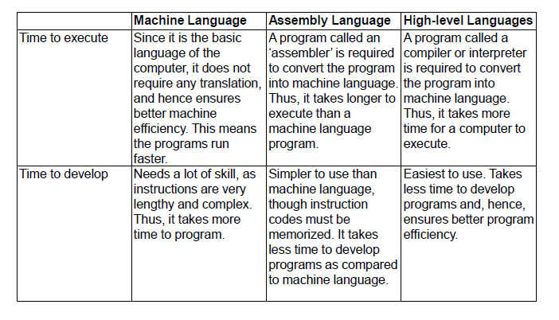
Comparison

